Slide 1
CRYPTOCURRENCY FLOW INVESTIGATION
Investigation became Easy and simplified..

Slide 2
TEAM DETAILS :
People who made the program LIVE…
TEAM NAME | TeamEternals
REGISTRATION ID | 1401
PROBLEM STATEMENT | Crypto Currency Flow Investigation
TEAM LEADER | Saran Kishore J S
TEAM MEMBERS | Sanjay K , Nithishwar V
INSTITUTION NAME | Sri Krishna College of Engineering and Technology
For more info:
E-mail: sarankishoreoffl@gmail.com

Slide 3
Problem Background
Crypto in Illicit Activities
Difficulty in Investigation
Cryptocurrency are being used in activities like fake dating profiles, ransomware, investment scams, darknet criminal businesses , and ponzi schemes.
Investigating the flow of cryptocurrency becomes difficult due to various methods of hiding and mixing funds.

Slide 4
CHALLENGES
Tracking Difficulty
Existing Tool
Tracking the flow of cryptocurrency is difficult, especially when funds are hidden in mixers, coin swap services, privacy coins, DeFi services, and layering services.
Free software like Blockexplorer, Metasleuth, and Etherscan have limitations in offering complete features for tracking and visualizing cryptocurrency flow.

Slide 5
WHAT IS OUR SOLUTION ?
TRACKER
VISUALIZATION
APPROACH
The way of tracking the transaction became simplified by the implementation of flow of currencies accross various accounts.
Our program demonstrates the flow with the help of chart which displays the total amount of currency transacted.
This system of approach creates a easy understanding to the investigators to fetch data from the specific blockchain.

Slide 6
KEY IDEAS IN MARKET OPPORTUNITY
RESEARCH NEW MARKETS
INNOVATIVE SOLUTIONS
Analyze existing customer needs and identify gaps in the market to find
new opportunities
Utilize technology and customer feedback to come up with novel solutions that meet your customer’s demands or needs
STAY AHEAD OF TRENDS
SEASONAL SPIKES
Monitor changes in the marketplace, such as shifts in consumer behavior or emerging technologies, to stay competitive and capitalize on new opportunities and trends
Identify times of year when demand for certain products may spike, such as holidays or special occasions, and use these times to target customers or maximize sales

Slide 7




TECHNOLOGY STACK
REACT JS
JSON
GRAPH QL
APIs

Slide 8
FLOW CHART
START
HOME - LOGIN
ANALYTICS
ENTER USER’S TRANSACTION ID
VARIOUS CRYPTO CURRENCY DETAILS ARE DISPLAYED
IF ID EXISTS
NO DATA FOUND
DISPLAYS THE TRANSACTION DETAILS
(GRAPHS)
END

Slide 9
5,50,000
1.7 Million
91%
Avg. Crypto Transactions per Day in India
No. of Ransomware crypto attacks per day in World
Avg. success rate of tracking fraud

Slide 10
NOVELTY
1. AUTHENTIC GRAPH FEATURE
Visualisation of fund flow in terms of graph indicating the amount to various IDs.
2. ANALYSED API’s
The security of each API’s is enhanced which results in fetching of data

Slide 11
3. SEAMLESS TRACKING
Limiting user access to accessing a blockchain is approached insuring correct security and control.
4. MULTIPURPOSE INTERFACE
The interface which includes the real-time showcase of all the types of Crypto Currencies.

Slide 12
Key Features:
Usage of Blockchain
Our project is completely based on the integration of blockchain technology which involves highly secured data fetchment.
FUTURE IMPLEMENTATION
On addition to the project we are going to construct a graph model which signifies the flow of currency and can easily track a specific transactions.
With enhanced user interface (UI).

Slide 13
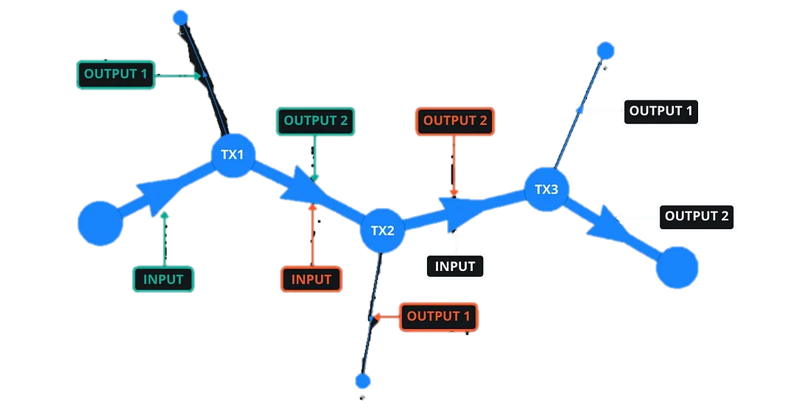
FINAL DESTINATION

Slide 14
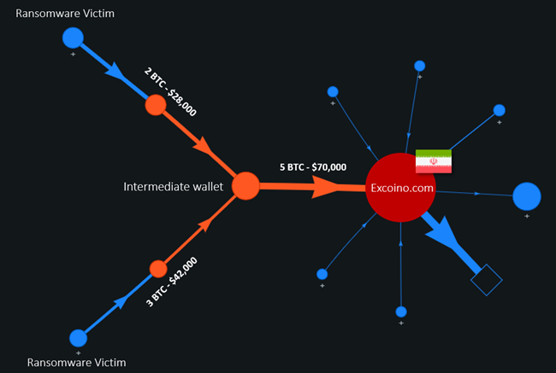
METHOD OF INVESTIGATION :

Slide 15
LIMITATIONS:
1. Anonymity:
Generally cryptocurrencies are designed with enhanced privacy features Hence,it is difficult to get user data eg. User info. , address and Kyc .
2. Offline Transactions:
Transactions conducted through offline are peer to peer may not be easily traceable.

Slide 16
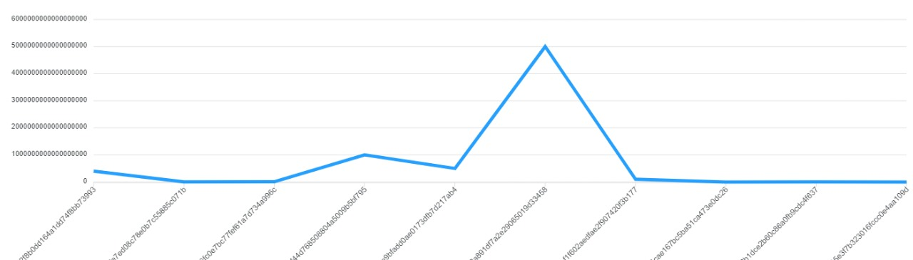
GRAPHICAL REPRESENTATION OF FLOW:
Bulk fund transferred
Quantity
X – axis shows the funds transferred to various accounts by transaction IDs.
Y – axis shows the actual amount that transferred.

Slide 17
Thanks!

